Slide 1
Welcome to Computer Aided Design and Dfarting presentation

Slide 2
HELLO!
I am Momtahin AHAMMED
Department : EEE
Section : E
ID : 19-40698-1
Submitted to : Nafish Sarwar Islam Assistant Professor, EEE

Slide 3
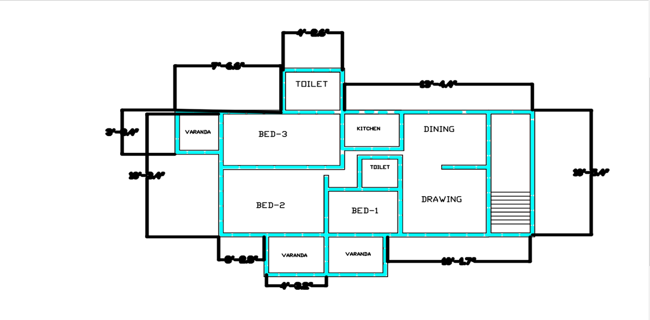
This is my first civil drawing
Where I have three
Bed rooms with one
Dinning and one drawings.

Slide 4
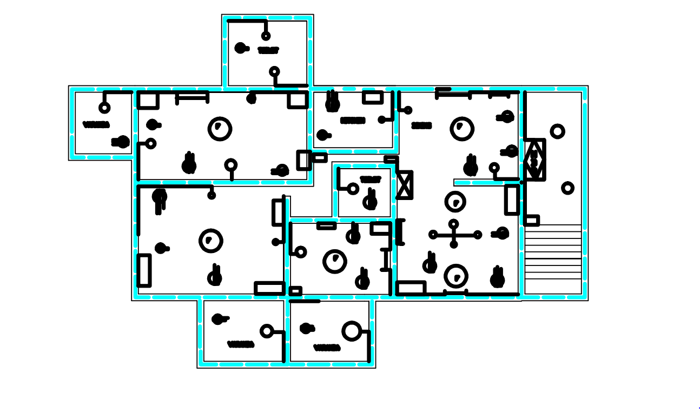
This is my second civil drawing with all loads like fans, lights, three pin and two pin sockets

Slide 5
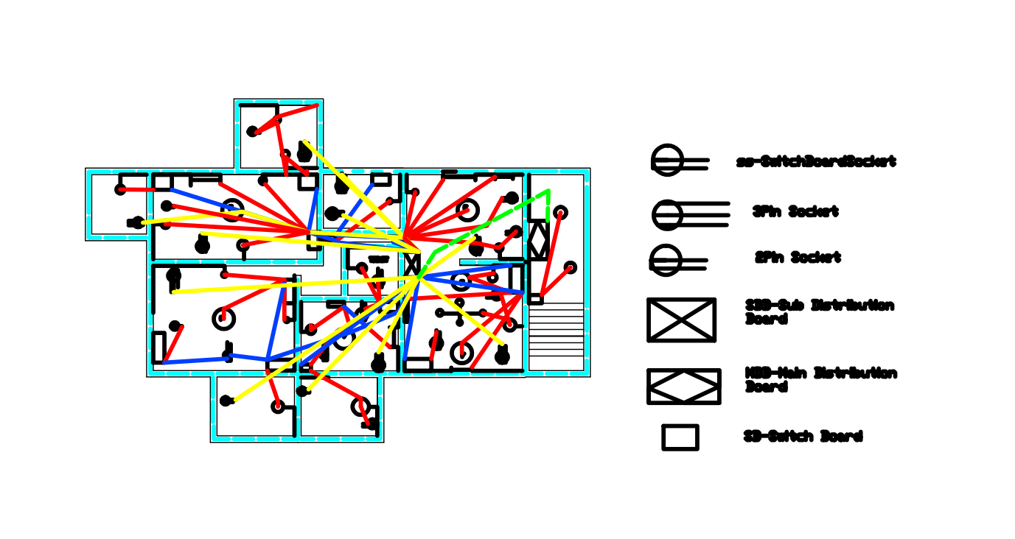
This is my third picture with all loads connections

Slide 6
THANKS!
Any questions?
find me at @amomtahin@gmail.com

